Slide 1
Signals
Dr. Michael Nasief

Slide 2
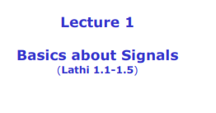
Ref: linear Systems and signals

Slide 4
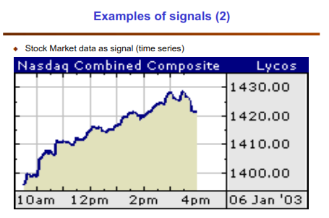

Slide 6
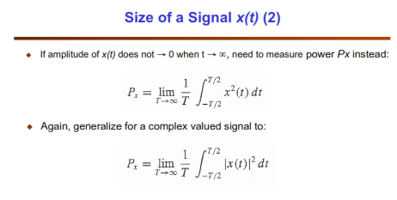

Slide 8
Compression
Expansion

Slide 14
